Slide 1
APPLICATIONS OF FOG COMPUTING IN SMART HEALTHCARE SYSTEMS
Presented by:
Samshul Ajam Ansari (13000119052)
Raushan Kumar(13000119033)
Aman Kumar (13000119032)
Uday Shankar Mardi (13000119021)
Mentor:
Dr. Naela Rizvi

Slide 2
Contents
Group-25 | Application of Fog Computing in Smart Healthcare Systems
Introduction
Smart Healthcare System
Merits
Demerits
Literature Survey
Proposed Methodology
Architecture
Case Study
Cloud Computing v/s Fog Computing
Benefits
Conclusion
Acknowledgement
References

Slide 3
Introduction
Group-25 | Application of Fog Computing in Smart Healthcare Systems
The history of human development has proven that medical and healthcare applications for humanity always are the main driving force behind the development of science and technology.
Traditional Healthcare system,
Patient needs visit the hospital
Time consuming
Lesser accessibility for the doctor
With the advent of cloud computing, the patient status is possible to collect, monitor and control remotely.
Cloud is also reliable, robust and provide powerful processing abilities.

Slide 4
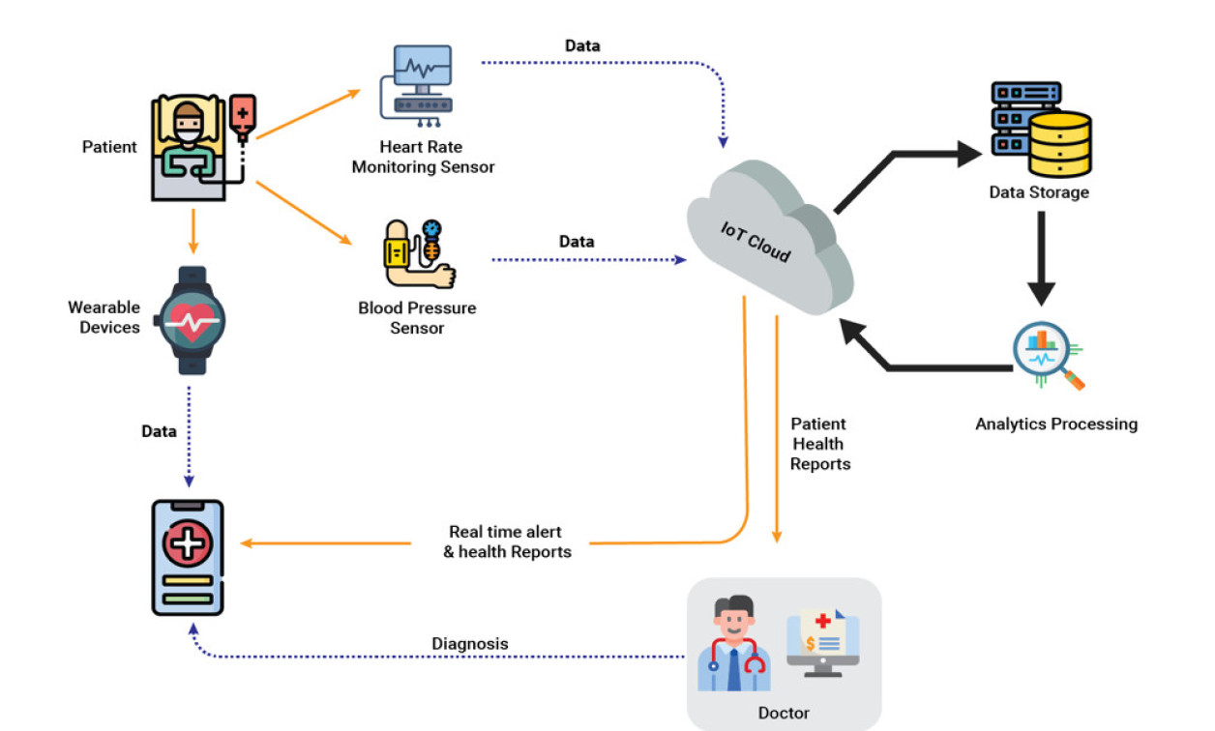
Smart Healthcare Systems
Group-25 | Application of Fog Computing in Smart Healthcare Systems
Consists of sensors mounted on the patient’s
body, a gateway device for interaction and
cloud servers for data storage and processing
Merits:
Real-time health monitoring
Better patient care
Facilitate telemedicine services and enable remote
consultation

Slide 5
Demerits
Group-25 | Application of Fog Computing in Smart Healthcare Systems
The frequency at which the data is sent and the amount of same is too high.
Increased bandwidth
Latency
Network Congestion
High service-response time
Data Privacy and security concerns
In delay-sensitive scenarios, related data should be processed in a very short time.
Healthcare
Surveillance Systems

Slide 6
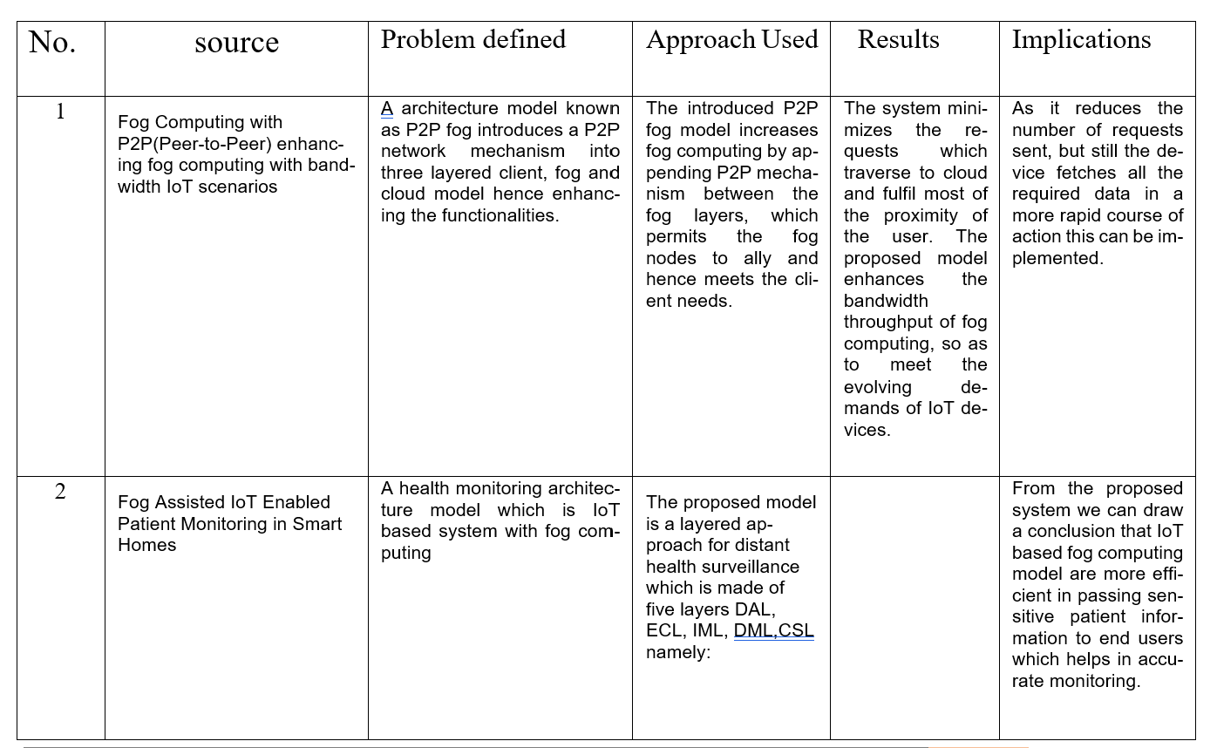
Literature Survey
Group-25 | Application of Fog Computing in Smart Healthcare Systems

Slide 7
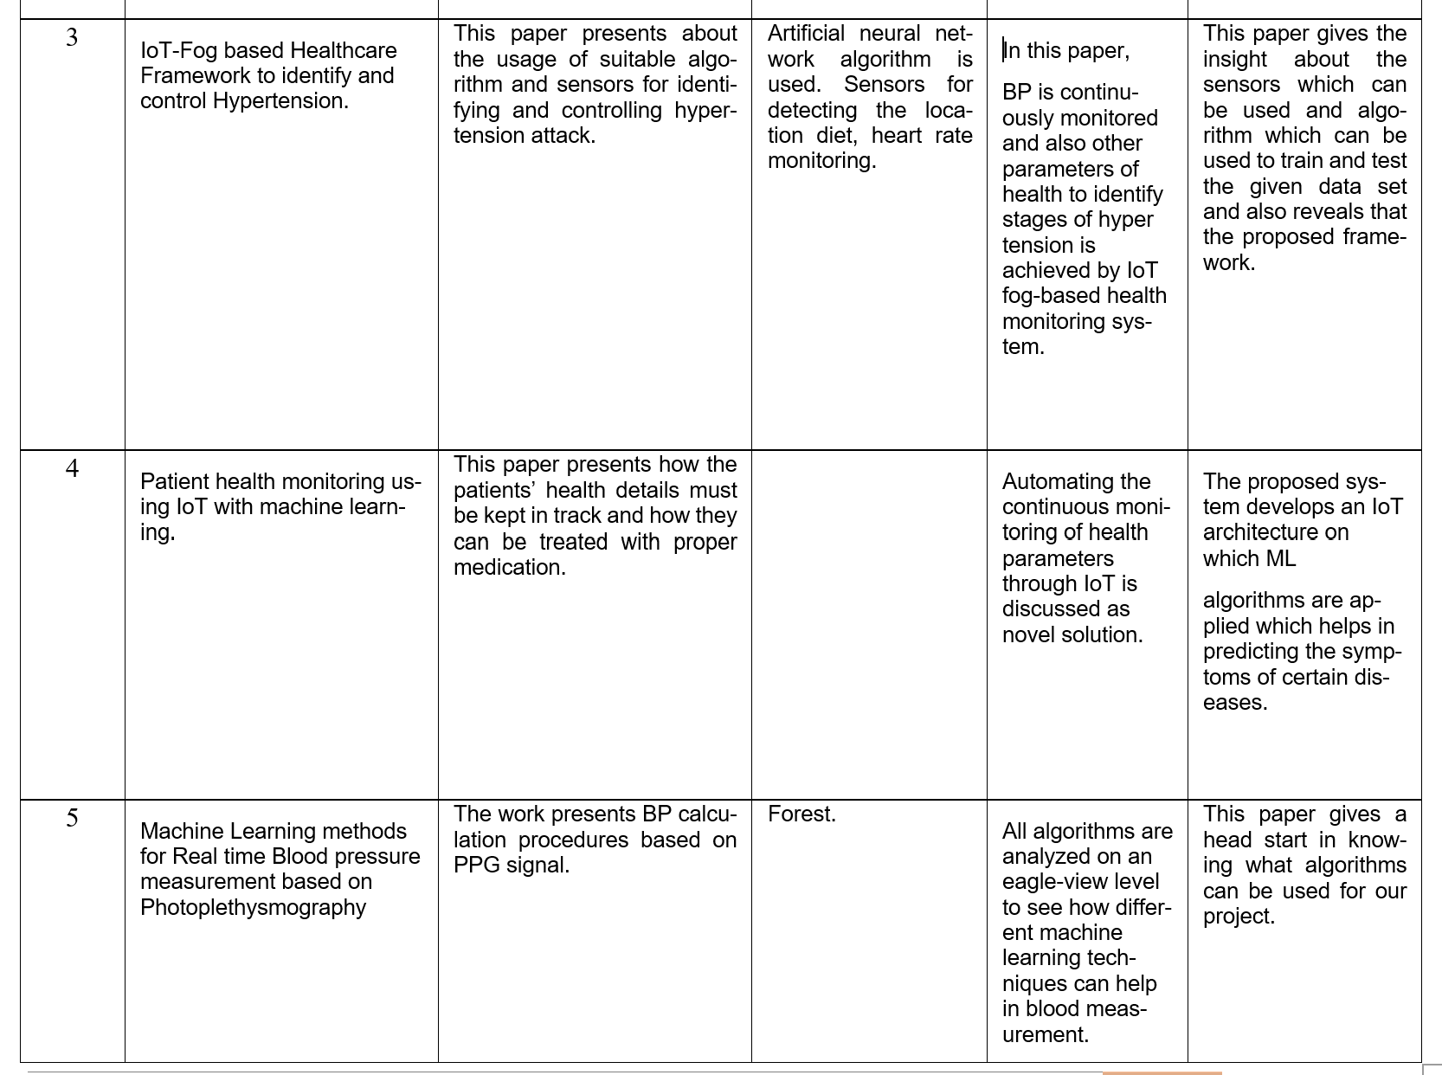
Literature Survey
Group-25 | Application of Fog Computing in Smart Healthcare Systems

Slide 8
Proposed Methodology
Group-25 | Application of Fog Computing in Smart Healthcare Systems
Integration of fog computing with IoT can be used to reduce the service response-time.
Fog computing is a decentralized computing paradigm that extends cloud computing capabilities to the edge of the network, closer to where data is generated and consumed.
Fog nodes can include routers, switches, gateways, servers, and other computing devices
Responsible for processing, analyzing, and storing data locally
Reduces the need for data to be transmitted to a centralized cloud server for processing
Employs a distributed architecture, allowing for parallel processing, scalability and fault tolerance.
Improved data privacy and security concerns

Slide 9
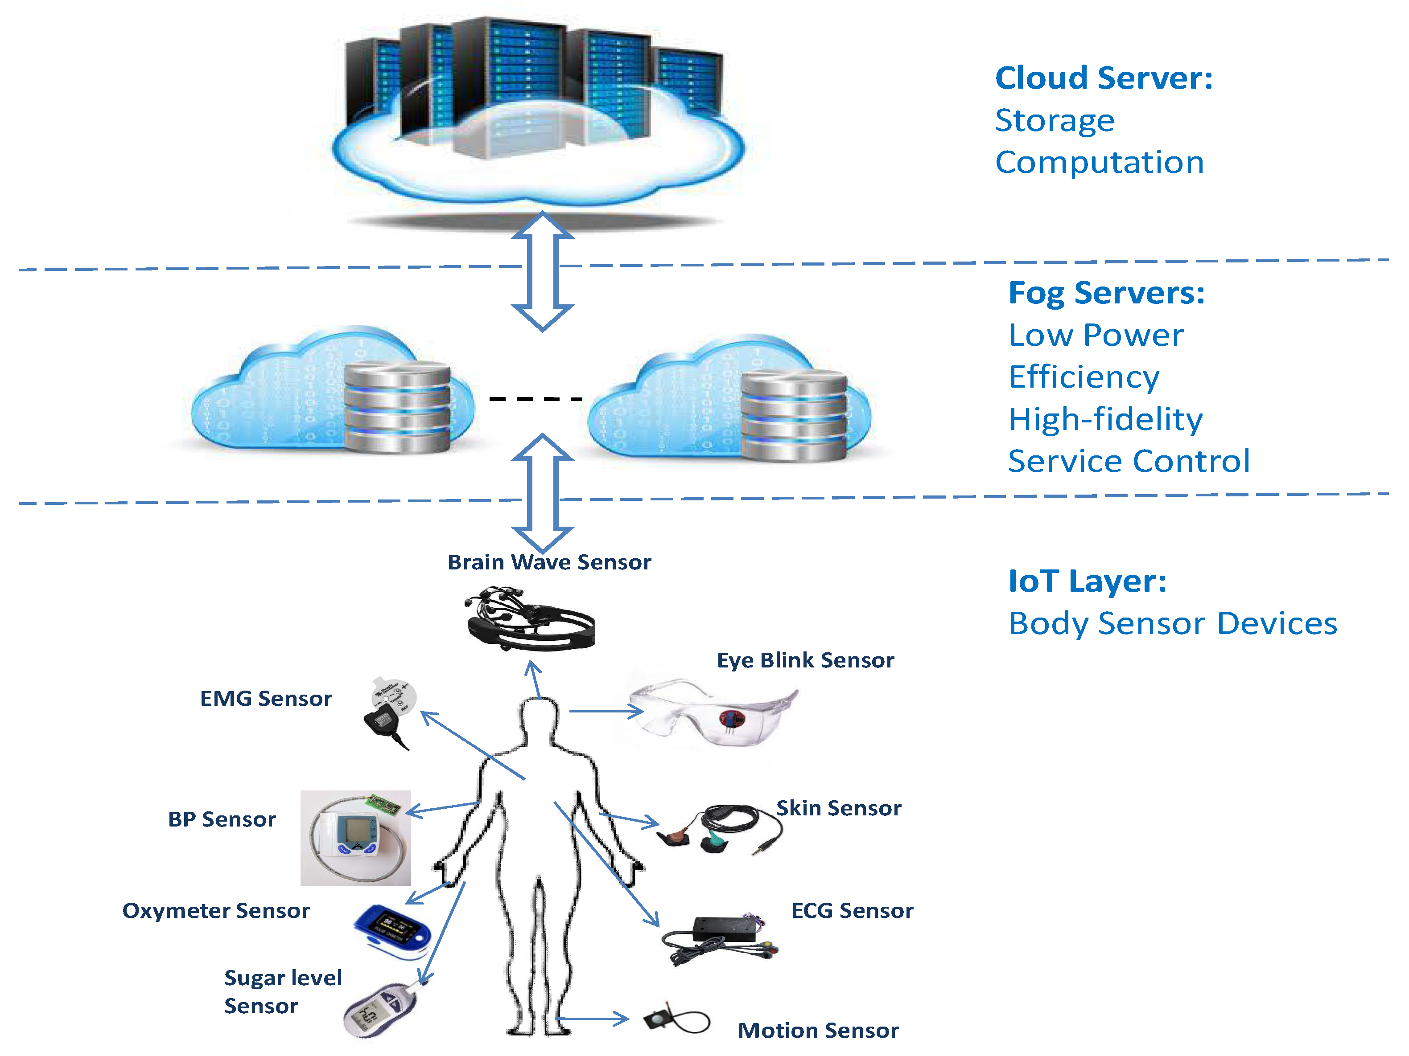
Architecture of Fog-based IoT Application
Group-25 | Application of Fog Computing in Smart Healthcare Systems

Slide 10
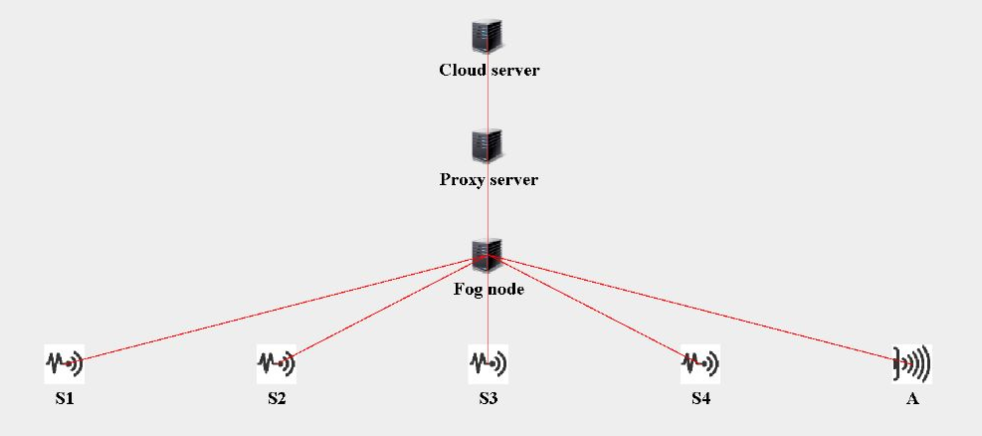
Simulation
Group-25 | Application of Fog Computing in Smart Healthcare Systems
Software used: iFogSim
S: Sensor
A: Actuator
Fig: Topology of Smart Healthcare for one patient

Slide 11
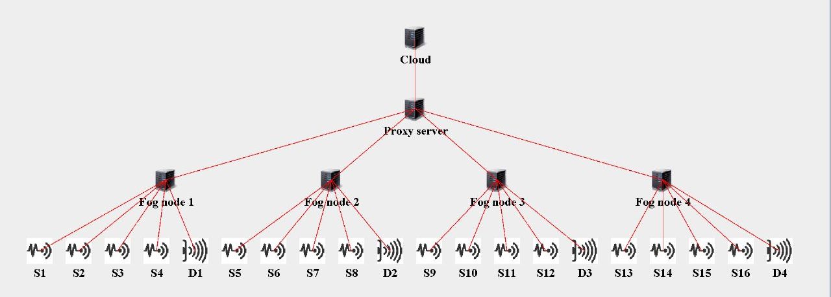
Simulation contd...
Group-25 | Application of Fog Computing in Smart Healthcare Systems
S: Sensor
D: Actuator
Fig: Topology of Smart Healthcare for multiple patients

Slide 12
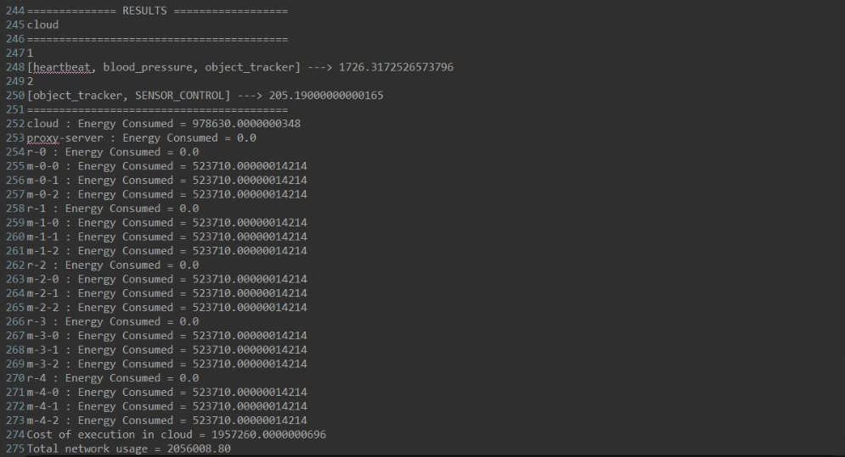
Simulation Result
Output:
Latency: 1726.32 ms
Total Network Usage: 2056008.80 kB
Fig: Simulation Result when the data is processed at cloud servers

Slide 13
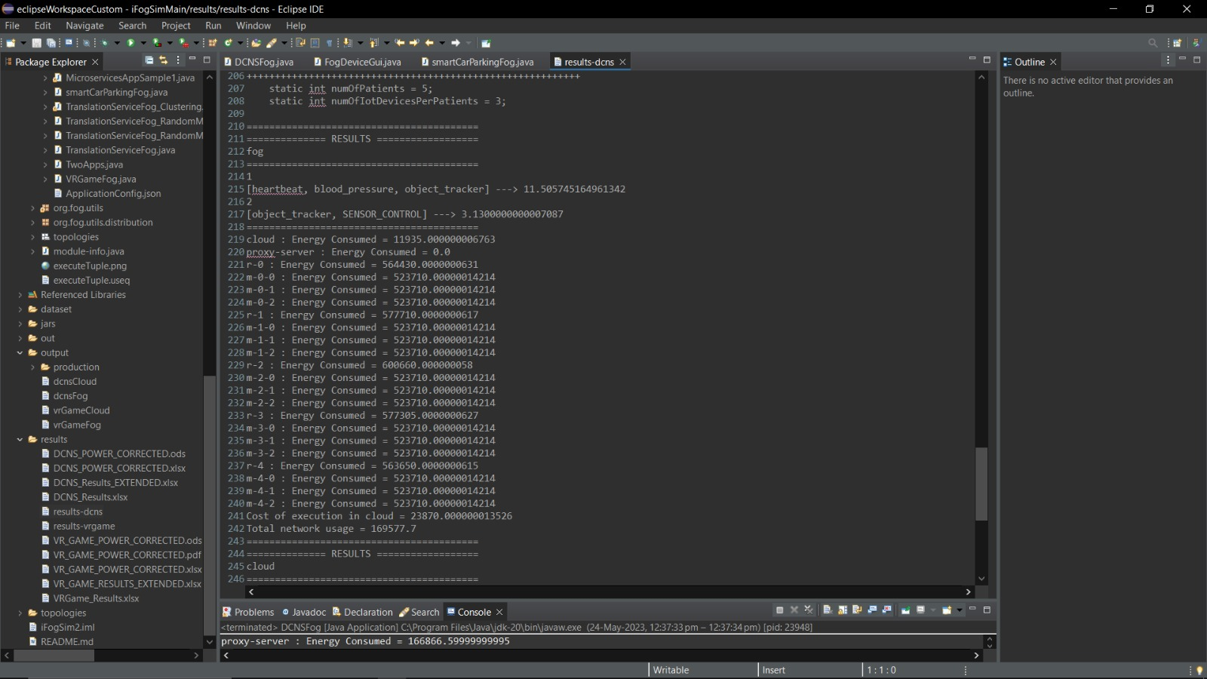
Simulation Result contd..
Output:
Latency: 11.51 ms
Total Network Usage: 169577.70 kB
Fig: Simulation Result when the data is processed at fog servers

Slide 14
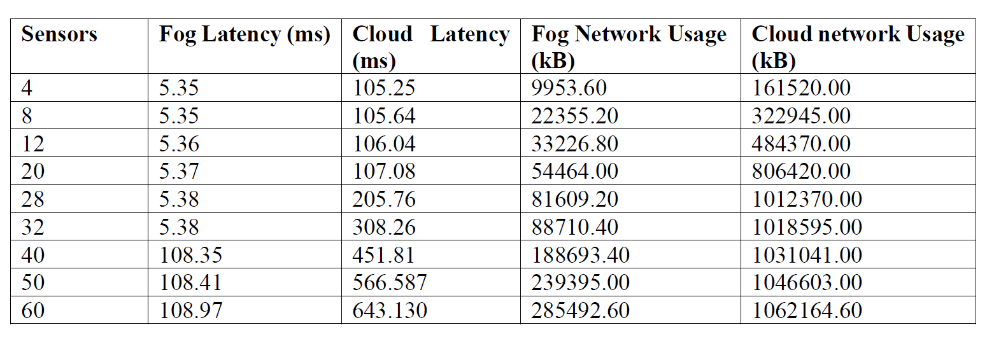
Simulation Result contd..
Table: Simulation results for the proposed smart healthcare system for fog and cloud

Slide 15
Performance Analysis
Latency
Network Usage

Slide 16
Benefits of fog Computing
Group-25 | Application of Fog Computing in Smart Healthcare Systems
Benefits of fog Computing include:
Machine learning models can also be integrated to fog servers to automate real decision making
Can be used to make smart predictions and send alerts based on the data received from the sensors and end-user devices.
Low latency
Bandwidth optimization
Enhanced Privacy and Security
Reliability and Availability
Scalibility

Slide 17
Conclusion
Group-25 | Application of Fog Computing in Smart Healthcare Systems
Fog computing brings cloud capabilities close to the end-user.
Fog computing-based IoHT applications
Reduced latency and congestion
Enhaced privacy and security
Improve reliability and Scalability
Can be used in truly real-time monitoring in ambulance emergency, rescue applications
Has the potential to revolutionize healthcare by enabling real-time, personalized, and efficient patient care

Slide 18
Acknowledgement
Group-25 | Application of Fog Computing in Smart Healthcare Systems
We would like to express our special thanks of gratitude to Professor, Dr. Naela Rizvi, who gave us the golden opportunity to work on this wonderful project, which also helped us in doing a lot of Research and we came to know about so many new things which helped in enhancing our knowledge, which also helped us a lot in preparing this project.
Last but not the least we convey our gratitude to all the teachers for providing us the technical skill that will always remain as our asset and to all non-teaching staffs for the gracious hospitality they offered us.

Slide 19
References
Group-25 | Application of Fog Computing in Smart Healthcare Systems
https://link.springer.com/article/10.1007/s40747-021-00582-9
https://www.sciencedirect.com/science/article/abs/pii/S0167739X19313391
https://www.researchgate.net/publication/339189991_The_Future_of_Healthcare_Internet_of_Things_A_Survey_of_Emerging_Technologies
https://ieeexplore.ieee.org/document/9380652
https://doi.org/10.1109/JIOT.2020.3044966
https://thesai.org/Downloads/Volume12No6/Paper_27-Fog_based_Remote_in_Home_Health_Monitoring.pdf

Slide 20

Group-25 | Application of Fog Computing in Smart Healthcare Systems

